Slide 1


Designing and Constructing Point-of-Care Device
Ali Fele Paranj
Yashar Moradi
Ehsan Shorezari
Plasma Competition
Sharif University of Technology

Slide 2
Our Group:
A short Introduction
Ali Fele Paranj : Physics
Yashar Moradi : Electronics
Ehsan Shorezari : Communication Engineering

Slide 3
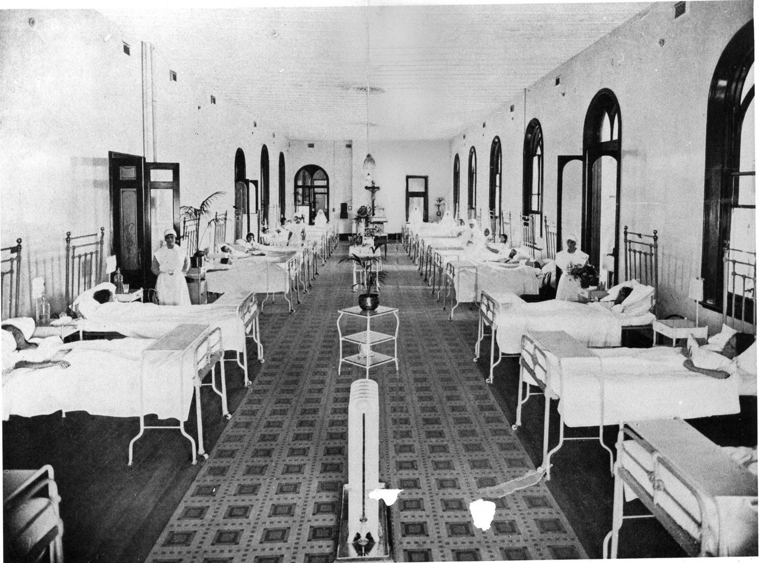
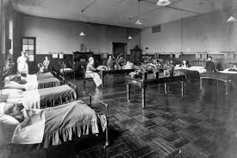
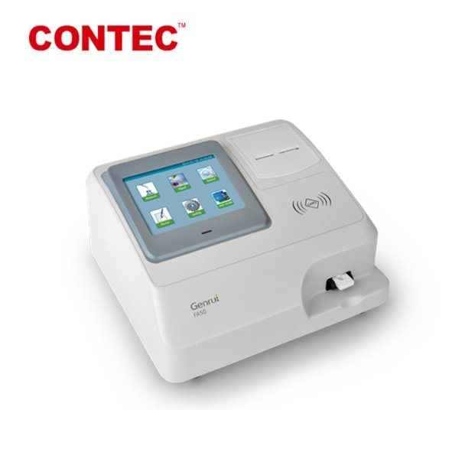
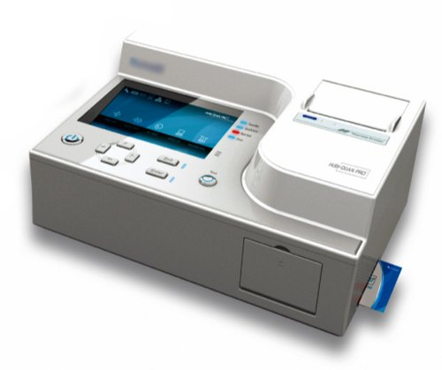
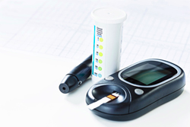
Why Point-of-Care devices?
In the past
Nowadays
testing was wholly or mostly confined to the medical laboratory
testing at or near the point of care—that is,
at the time and place of patient care

Slide 4
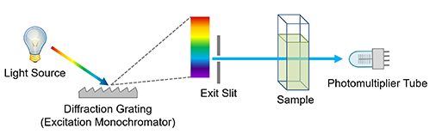
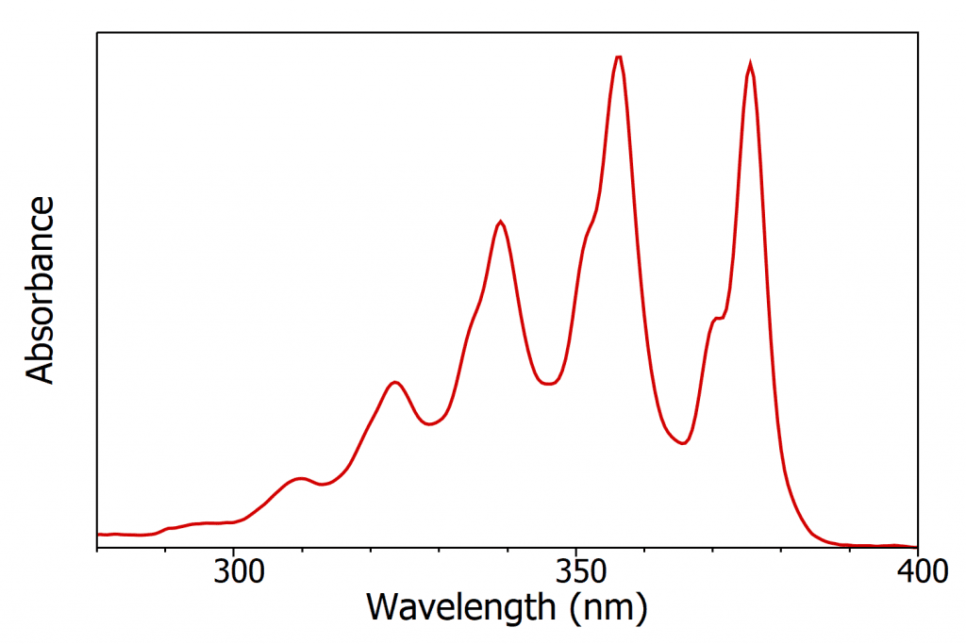
Spectroscopy

Slide 5
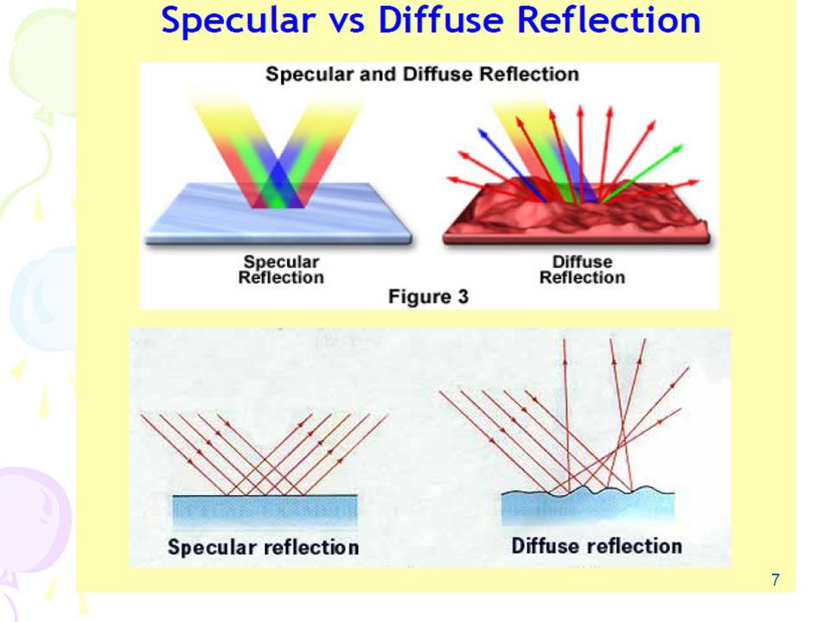
Types of Reflection

Slide 6
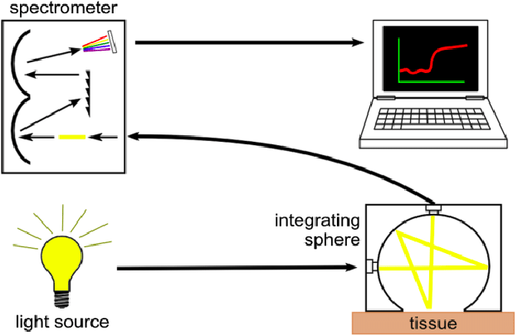
Reflectance Spectroscopy
For Powders
For little amounts of specimen

Slide 7
Three approaches
Three light sources
One light Source + Diffraction Grating + Mirrors
One light Source + Diffraction Grating

Slide 8
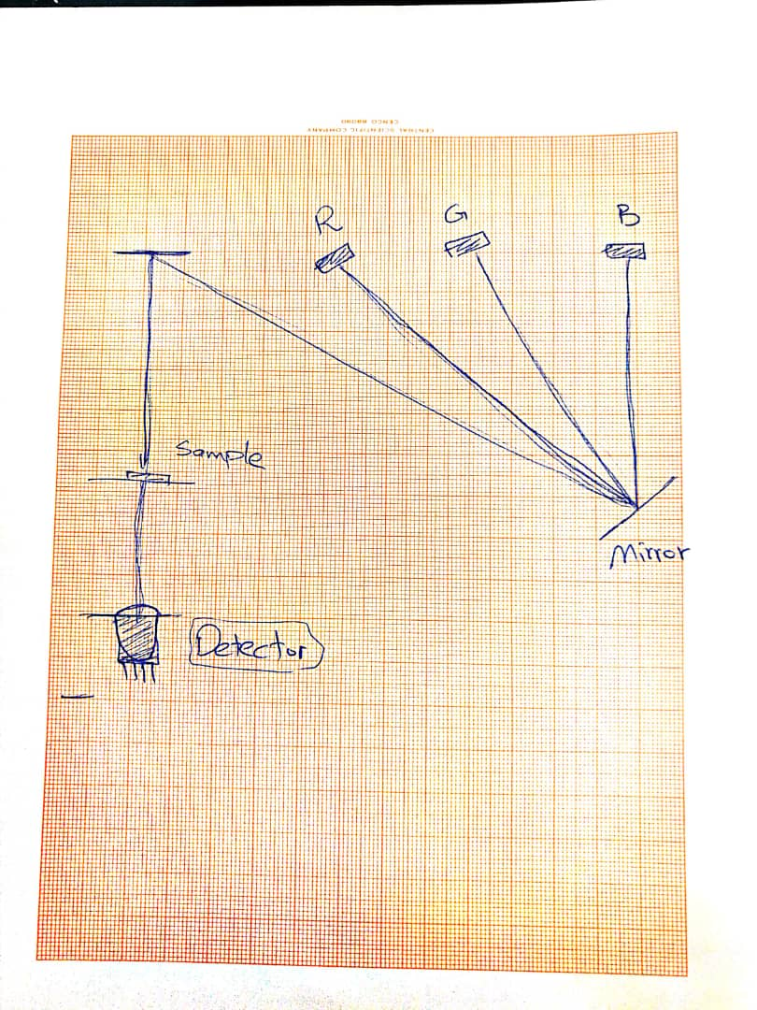
Three light sources

Slide 9
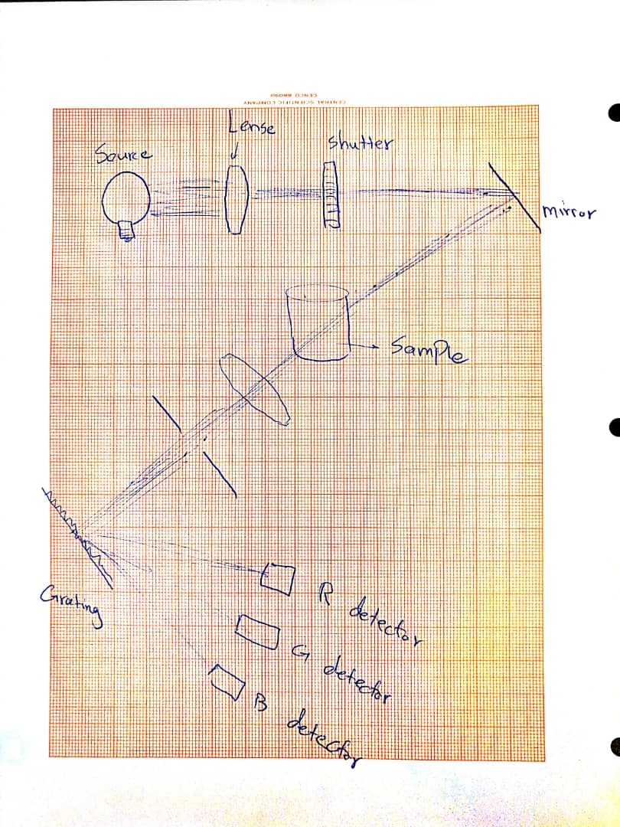
One light Source + Diffraction Grating

Slide 10
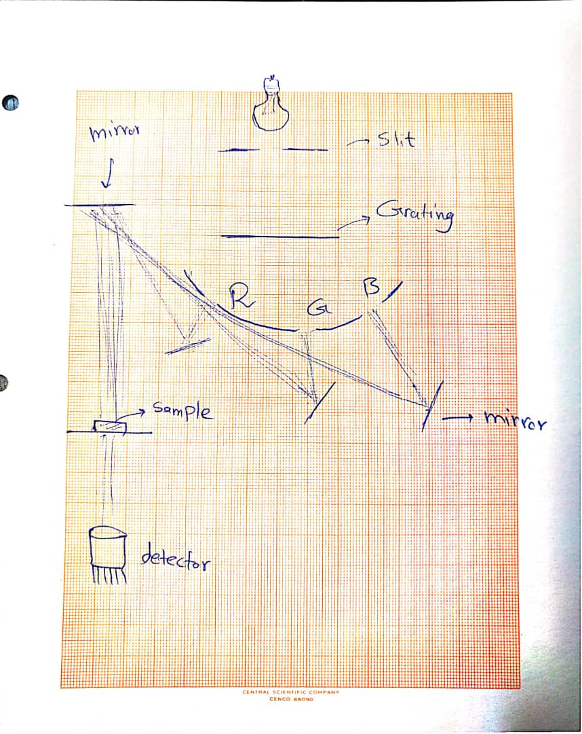
One light Source + Diffraction Grating + Mirror

Slide 11
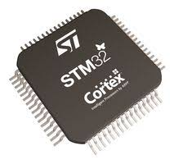

Electronics and Peripherals
ARM Cortex-m ( STM32 ) as the processor
which supports:
I2C, UART, SPI
ADC
LOW power consumption
Boot loader

Slide 12
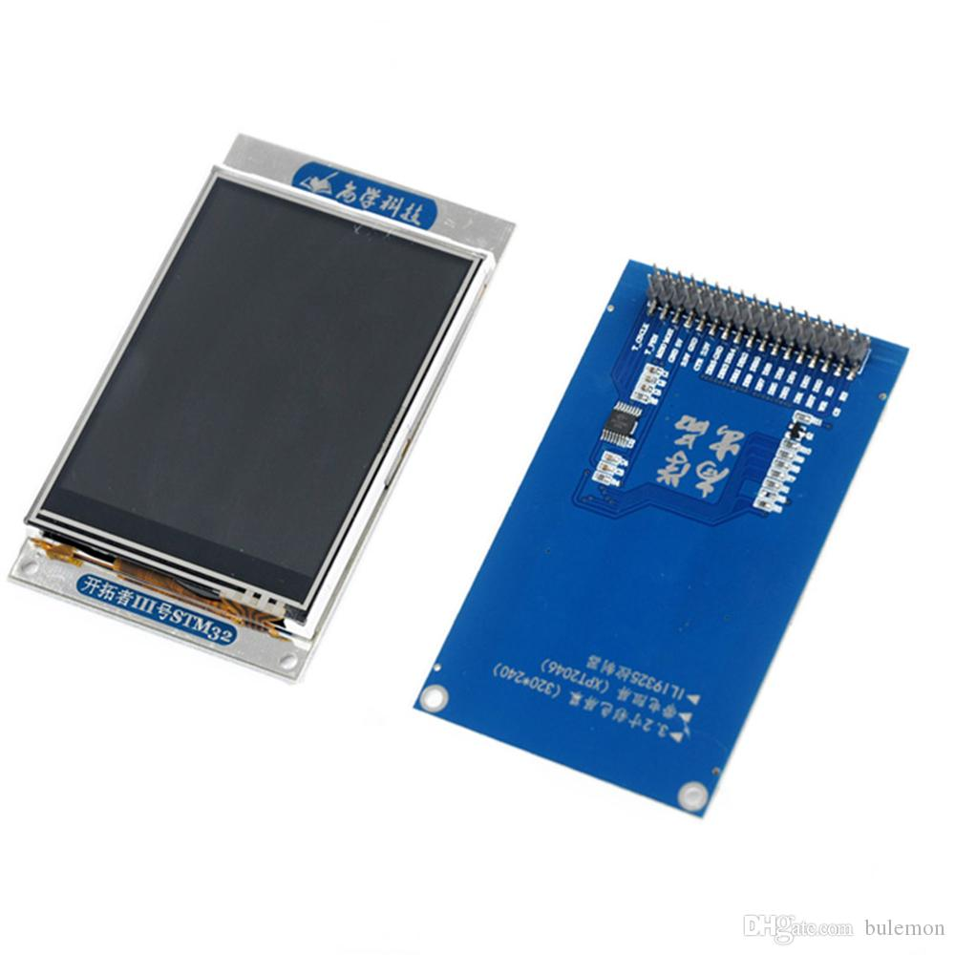
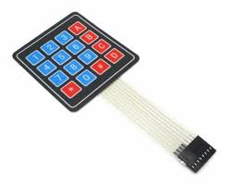
Electronics and Peripherals
Screen with touch (or may be with keypad)

Slide 13


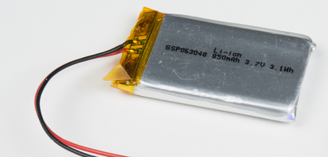

Electronics and Peripherals
Battery based
Can be synced with Smart Phone Via Bluetooth or WIFI.

Slide 14

Electronics and Peripherals
Saving Data on SD card
Log data to computer (is still optional)

Slide 15
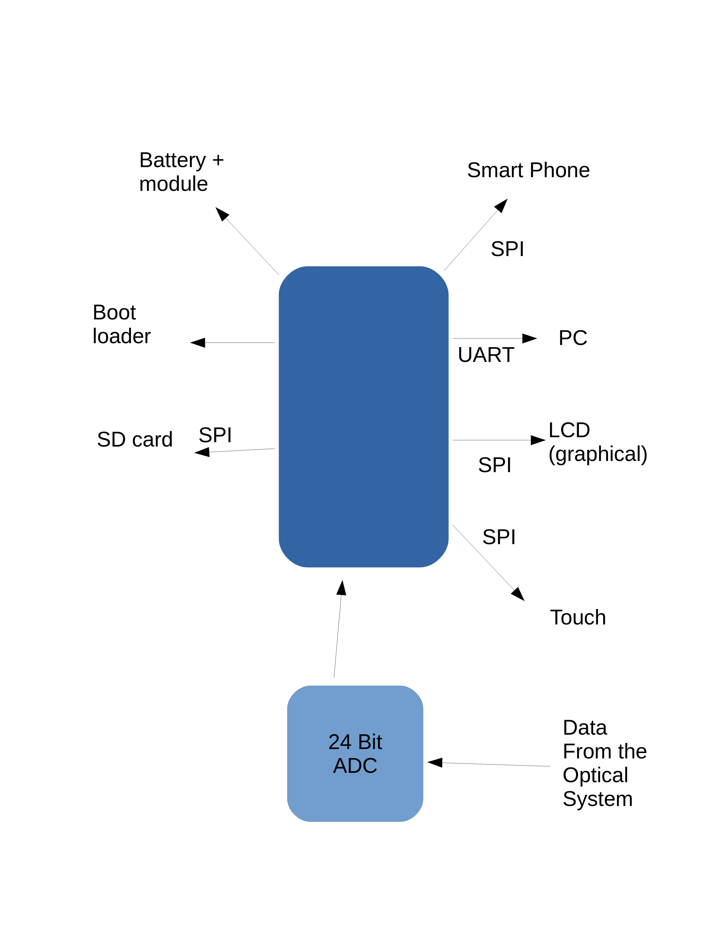
Peripherals

Slide 16
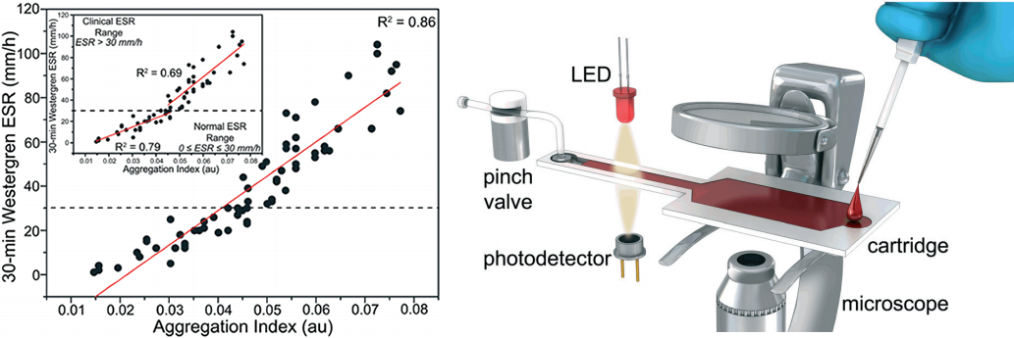
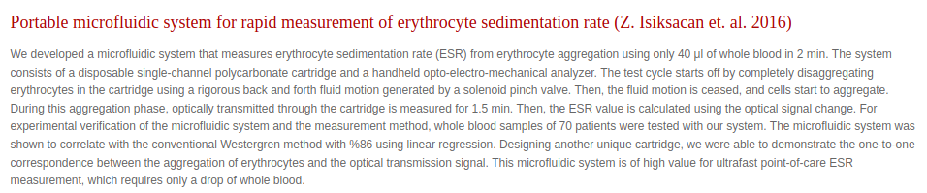
Similar Products

Slide 17
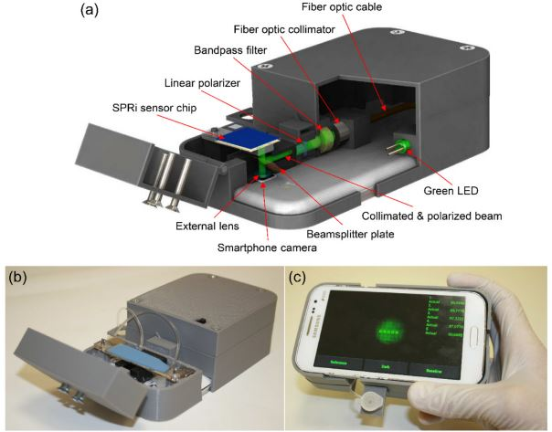
Similar Products

Slide 18
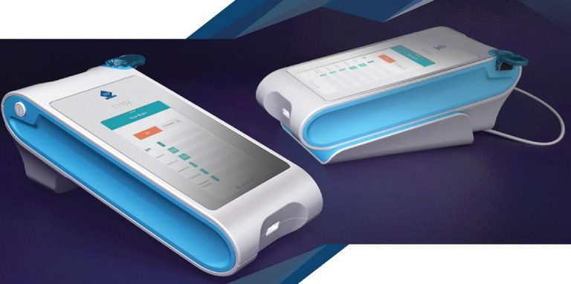
Similar Products

Slide 19

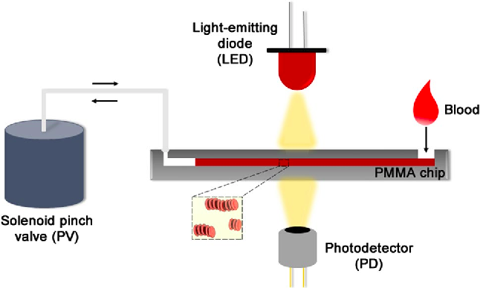
Similar Products

Slide 20

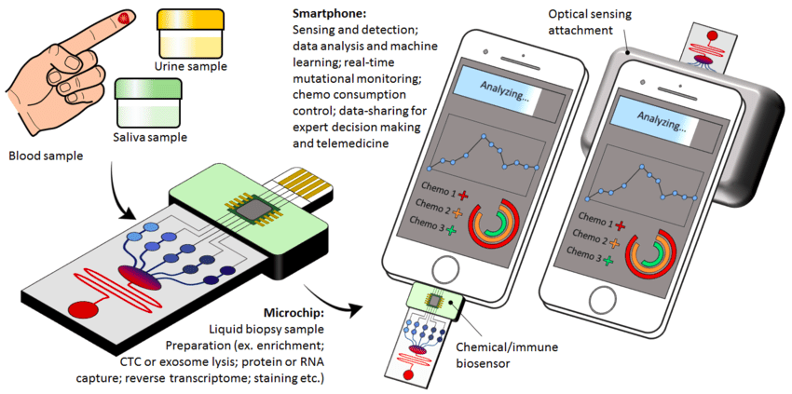
Similar Products

Slide 21
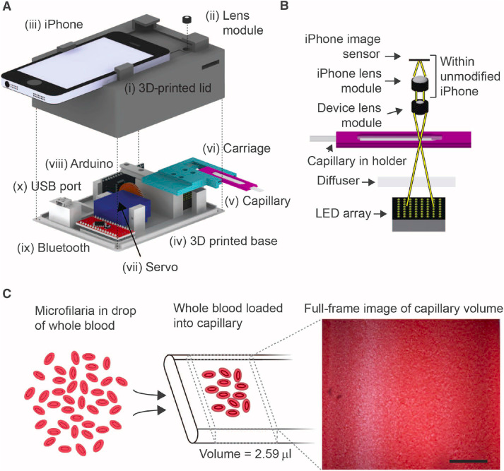
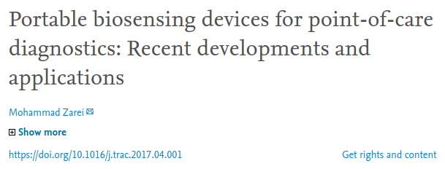
Similar Products

Slide 23
Thank you for your attention

